Slide 1
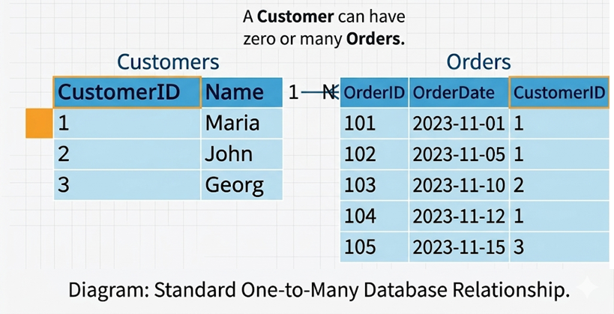
Relationships:
One-to-many
One to One
Many to Many
One-to-many

Slide 2
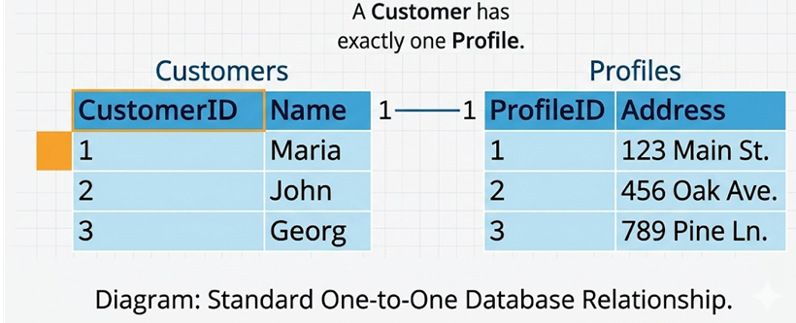
One-to-One

Slide 3
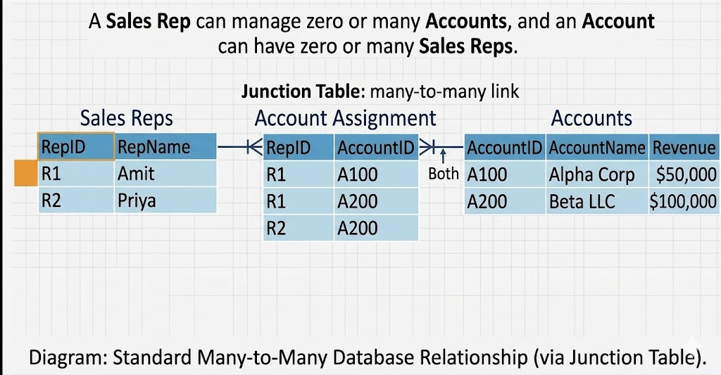
Many to Many

Slide 4
Star Schema vs. Snowflake Schema:
Before we go for Star Schema and Snowflake Schema 1st we need to understand what is Fact Table and Dimension Table

Slide 6
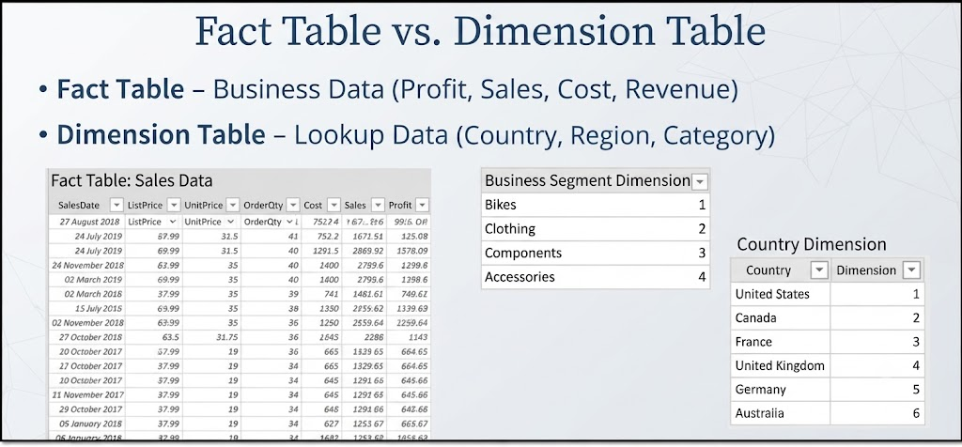
Fact Table: Stores quantitative, measurable metrics and foreign keys, recording specific business events or transactions (e.g., sales revenue, quantity sold).
Dimension Table: Stores descriptive attributes and context about the facts, allowing users to filter, group, and label data (e.g., customer names, product categories, dates).

Slide 7
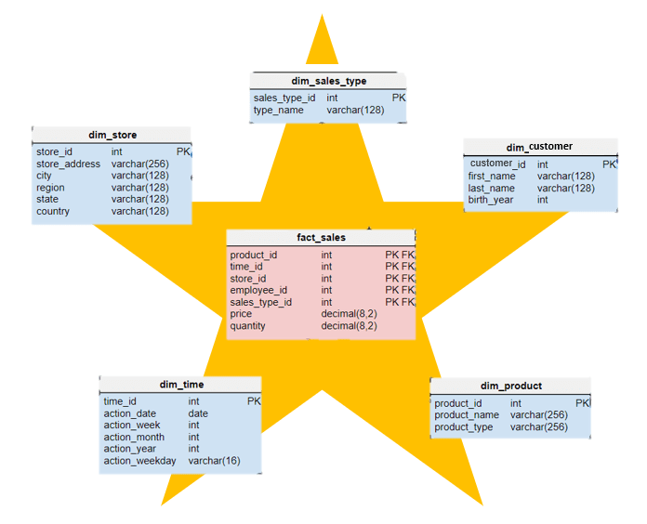
Star Schema
Every Dimension table is connected to the Fact Table.

Slide 8
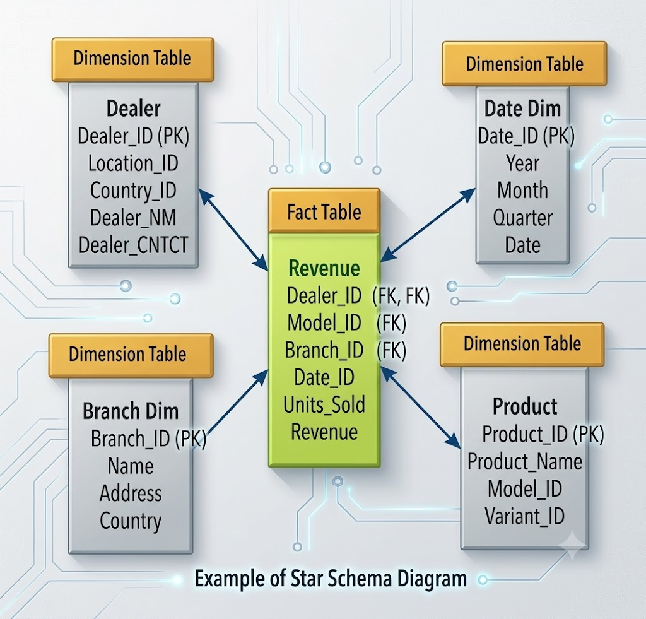
Every Dimension table is connected to the Fact Table.

Slide 9

A snowflake is a tiny crystal of ice that forms in clouds when water vapor freezes around a small particle, such as dust or pollen.

Slide 10
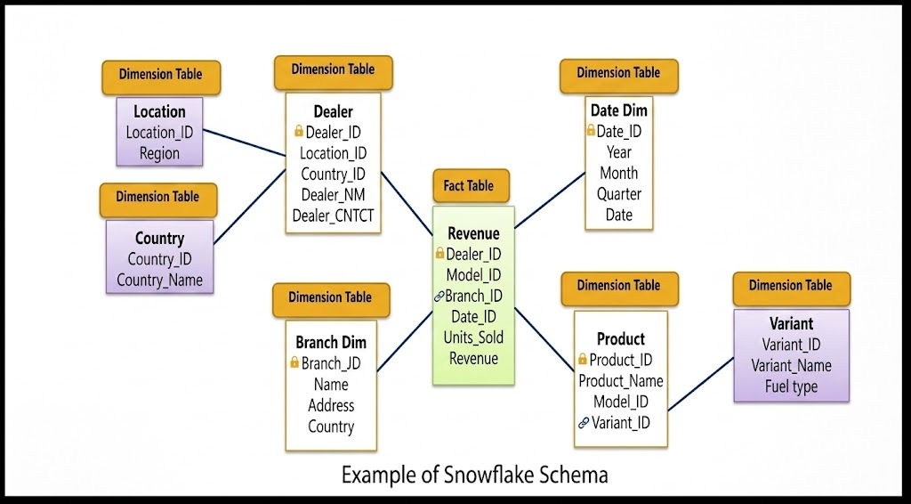
Snowflake Schema:

Slide 11
Snowflake Schema:
A Snowflake Schema is a type of database/data warehouse schema where Dimensions table of Start Schema is further connected to the other Dimension Table

Slide 12
Dax
There are more than 200 DAX functions in power BI.
Some important as below.
Aggregation functions
Aggregation functions return a scalar value applying an aggregation function to a column or to an expression evaluated by iterating a table expression.
Date and Time functions
Date and time functions help creating calculations based on dates and time.
Filter functions
Filter functions manipulate table and filter contexts.
Information functions
Information functions provide information about data type or filter context of the argument provided.
Logical functions
Logical functions act upon an expression to return information about the values or sets in the expression.
Aggregation functions: SUM, AVERAGE, MIN, MAX, COUNT
Date and Time functions: CALENDAR, DATEVALUE, DAY, MONTH, YEAR
Filter functions: CALCULATE, FILTER, ALL, ALLEXCEPT, RELATED
Information functions: ISBLANK, ISERROR, ISNUMBER, ISTEXT, USERNAME
Logical functions: AND, OR, NOT, IF, SWITCH

Slide 13
Aggregation functions
Aggregation functions return a scalar value applying an aggregation function to a column or to an expression evaluated by iterating a table expression.
Total_Sales = SUM(Sales[Amount])
Order_Count = COUNT(Sales[OrderID])
Average_Price = AVERAGE(Products[Price])
DistinctValue = DISTINCTCOUNT(Data[Beverage Brand])
Profit Margin % = DIVIDE([Profit], [Total Revenue])
Min
Max

Slide 14
Date and Time functions
Date and time functions help creating calculations based on dates and time.
DATE | TargetDate = DATE(2026, 06, 02)
DATEDIFF | DaysPassed = DATEDIFF(OrderDate, ShipDate, DAY)
DATEVALUE | ConvertedDate = DATEVALUE("2026-06-02")
DAY | DayNumber = DAY(Sales[InvoiceDate])
EDATE | TwoMonthsLater = EDATE(Sales[OrderDate], 2)
EOMONTH | MonthEnd = EOMONTH(Sales[OrderDate], 0)
HOUR | OrderHour = HOUR(Sales[Timestamp])
MINUTE | OrderMinute = MINUTE(Sales[Timestamp])
MONTH | MonthNumber = MONTH(Sales[OrderDate])
NOW | CurrentTimestamp = NOW()
QUARTER | CurrentQuarter = QUARTER(Sales[OrderDate])
SECOND | OrderSecond = SECOND(Sales[Timestamp])
TIME | ShiftStart = TIME(9, 0, 0)
TIMEVALUE | ConvertedTime = TIMEVALUE("13:30:00")
TODAY | CurrentDate = TODAY()
WEEKDAY | DayOfWeek = WEEKDAY(Sales[OrderDate], 2)
WEEKNUM | WeekOfYear = WEEKNUM(Sales[OrderDate])
YEAR | OrderYear = YEAR(Sales[OrderDate])

Slide 15
Information functions
Information functions provide information about data type or filter context of the argument provided.
ISBLANK | ISBLANK(Sales[Discount])
ISERROR | ISERROR(Sales[TotalAmount] / Sales[Quantity])
ISNUMBER | ISNUMBER(Sales[PostalCode])
ISTEXT | ISTEXT(Sales[ProductCode])
HASONEVALUE | HASONEVALUE(Product[Category])
HASONEFILTER | HASONEFILTER(Product[SubCategory])
NONBLANKROWCOUNT | RowCount = NONBLANKROWCOUNT(Customers)
USERNAME | CurrentUser = USERNAME()
USERPRINCIPALNAME | UserEmail = USERPRINCIPALNAME()

Slide 16
Logical functions
Logical functions act upon an expression to return information about the values or sets in the expression.
AND | AND(Sales[Amount] > 100, Sales[Region] = "West")
OR | OR(Sales[Quantity] > 10, Sales[Discount] > 0.1)
NOT | NOT(Sales[Status] = "Cancelled")
IF | IF(Sales[Amount] >= 500, "High Value", "Standard")
SWITCH | SWITCH(Sales[RegionCode], 1, "North", 2, "South", 3, "East", 4, "West", "Unknown")
IFERROR | IFERROR(Sales[Revenue] / Sales[Units], 0)
COALESCE | COALESCE(Sales[AltPhone], Sales[HomePhone], "No Number")
FALSE | SetFalse = FALSE()
TRUE | SetTrue = TRUE()

Slide 17
Filter & Calculate functions
Filter functions manipulate table and filter contexts.
CALCULATE | CALCULATE(SUM(Orders[Amount]), Orders[Region] = "West")
FILTER | FILTER(Orders, Orders[Amount] > 1000) FILTER(Orders, Orders[Category] = “Furntiture”)
ALL | SUM(Orders[Amount]) / CALCULATE(SUM(Orders[Amount]), ALL(Sales))
ALLEXCEPT | CALCULATE(SUM(Orders[Amount]), ALLEXCEPT(Geography, Geography[State]))
ALLSELECTED | CALCULATE(SUM(Orders[Amount]), ALLSELECTED(Orders))
RELATED | RELATED(Product[Price])

Slide 21
Data Modelling
Relationships Cardinality & Cross Filter Direction :
Star Schema vs. Snowflake Schema: Structural organization of Fact and
Dimension tables.
Creating & Managing Relationships: Active vs. inactive relationship paths.
Date Table Creation: Generating continuous calendar dimensions for Time
Intelligence functions.
Hierarchies:
Parent-child drill-down paths (e.g., Year > Quarter > Month > Day).

